Slide 1
The Basic Practice of Statistics Ninth Edition David S. Moore William I. Notz
Chapter 9
Producing Data:
Experiments
Lecture Slides
© 2021 W. H. Freeman and Company

Slide 2
In Chapter 9, we cover …
Observation versus experiment
Subjects, factors, and treatments
How to experiment badly
Randomized comparative experiments
The logic of randomized comparative experiments
Cautions about experimentation
Matched pairs and other block designs

Slide 3
Recalling: explanatory variable versus response variable
In a study to relate two conditions, researchers often define one as the explanatory variable and other as the outcome or response variable.
In a study to determine whether surgery or chemotherapy results in higher survival rates for a certain type of cancer, whether the patient survived is one variable, and whether he or she received surgery or chemotherapy is the other.
Which is the explanatory variable and which is the response variable?

Slide 4
Explanatory variable is one that may explain or may cause differences in a response variable (or outcome variable).

Slide 5
Randomized Experiment versus Observational Studies
Randomized experiment: create differences in the explanatory variable and examine results (response variable).
Observational study: observe differences in the explanatory variable and notice whether these are related to differences in the response variable.

Slide 6
Two reasons why we must sometimes
use an observational study instead of an experiment …
It is unethical or impossible to assign people to receive a specific treatment.(e.g, smoking)
Certain explanatory variables are inherent traits and cannot be randomly assigned. (e.g., handedness)

Slide 7
Observational study versus experiment
In contrast to observational studies, experiments don’t just observe individuals or ask them questions. They actively impose some treatment in order to measure the response.
OBSERVATIONAL STUDY VERSUS EXPERIMENT
An observational study observes individuals and measures variables of interest, but it does not attempt to influence the responses. The purpose of an observational study is to describe some group or situation.
An experiment, on the other hand, deliberately imposes some treatment on individuals to observe their responses. The purpose of an experiment is to study whether the treatment causes a change in the response.
When our goal is to understand cause and effect, experiments are the preferred source for fully convincing data.
The distinction between observational studies and experiments is one of the most important in statistics.

Slide 8
Confounding
A lurking (or confounding) variable is a variable that is not among the explanatory or response variables in a study but that may influence the response variable.
Two variables (an explanatory variable and a lurking variable) are confounded when their effects on a response variable cannot be separated from each other.
Confounding is a bigger problem in observational studies. Observational studies of the effect of one variable on another often fail because of confounding between the explanatory variable and one or more lurking variables.
Well-designed experiments take steps to avoid confounding.

Slide 9
Confounding - example
Study of the relationship between smoking during pregnancy and child’s subsequent IQ a few years after birth.
Explanatory variable: whether or not the mother smoked during pregnancy
Response variable: subsequent IQ of the child
Women who smoke may also have poor nutrition, lower levels of education, or lower income.
Possible Confounding Variables: Mother’s nutrition, education, and income.

Slide 10
Subjects, factors, and treatments
An experiment is a statistical study in which we actually do something (apply a treatment) to people, animals, or objects to observe the response. Here is the basic vocabulary of experiments.
The individuals studied in an experiment are often called subjects, particularly when they are people.
The explanatory variables in an experiment are often called factors.
A treatment is any specific experimental condition applied to the subjects. If an experiment has more than one factor, a treatment is a combination of specific values of each factor.

Slide 11
How to experiment badly (1of 3)
Experiments don’t guarantee good data.
Good designs are essential for effective experiments, just as they are for sampling.
Example: A college regularly offers a review course to prepare students for the GMAT. This year, it will offer only an online version of the course.
Students → Online Course → GMAT Scores
Suppose the results were 10% higher than the long-term average for those who took the classroom review course.
Can we conclude that the online course is more effective?

Slide 12
How to experiment badly (2 of 3)
No, we cannot conclude that the online course is more effective.
A closer look at the course reveals that students in the current year are older and more mature than in previous years. This may have contributed to higher GMAT scores.
The effect of online versus in-person class is confounded with the effect of lurking variables.
This is an example of an uncontrolled experiment.
Solution: randomized students in the same year to online and in-person class groups.

Slide 13
How to experiment badly (3 of 3)
Many laboratory experiments use a design like the one in the online GMAT course example:
In the laboratory environment, simple designs often work well.
Field experiments and experiments with animals or people deal with more variable conditions.
Outside the laboratory, badly designed experiments often yield worthless results because of confounding with lurking variables.
Subjects
Treatment
Measure Response

Slide 14
Randomized comparative experiments (1 of 2)
The remedy for confounding is to perform a comparative experiment in which some individuals receive one treatment and similar units receive another. Most well-designed experiments compare two or more treatments.
Some experiments may include a control group that receives an inactive treatment (placebo) or an existing baseline treatment.
An experiment that uses both comparison of two or more treatments and random assignment of subjects to treatments is a randomized comparative experiment.

Slide 15
Randomized comparative experiments (2 of 2)
Comparison alone isn’t enough. If the treatments are applied to groups that differ greatly, bias will result. The solution to the problem of bias is random assignment.
In an experiment, random assignment means that individuals are assigned to treatments at random—that is, using some sort of chance process.
COMPLETELY RANDOMIZED DESIGN
In a completely randomized experimental design, all the subjects are allocated at random among all the treatments.
Group 1
Treatment 1
Random assignment
Compare results
Experimental units
Group 2
Treatment 2

Slide 16
The logic of randomized comparative experiments (1 of 2)
Random assignment of subjects forms groups that should be similar in all respects before the treatments are applied.
A comparative experiment with randomization ensures that influences other than the experimental treatments operate equally on all groups.
Differences in average response must be due either to the treatments or to the play of chance in the random assignment of subjects to the treatments.

Slide 17
The logic of randomized comparative experiments (2 of 2)
PRINCIPLES OF EXPERIMENTAL DESIGN
The basic principles of statistical design of experiments are:
Control—restrict the effects of lurking variables on the response, most simply by comparing two or more treatments.
Randomization—use chance to assign subjects to treatments.
Replication—use enough subjects in each group to reduce chance variation in the results.
An observed effect so large that it would rarely occur by chance is called statistically significant.
A statistically significant association in data from a well-designed experiment does imply causation.

Slide 18
Cautions about experimentation
The logic of a randomized comparative experiment depends on our ability to treat all the subjects the same in every way, except for the actual treatments being compared.
Many medical experiments are, for example, “placebo controlled.”
A placebo is a dummy treatment that is as similar to the treatment as possible but contains no “active ingredient.”
double-blind experiments
In a double-blind experiment, neither the subjects nor those who interact with them and measure the response variable know which treatment each subject is receiving.
Even these have been criticized for lack of realism.

Slide 19
Control Groups, Placebos, and Blinding
Control Groups
Handled identically to the treatment group(s) in all respects, except that they don’t receive the actual treatment.
Placebos
Research shows people also respond to placebos – looks like the real drug but has no active ingredients.
Randomly assign some patients to receive the drug and others to receive a placebo, without telling which they are receiving.
Blinding
Double-blind: neither the participant nor the researcher taking measurements know who had which treatment.
Single-blind: only one of the two (participant or researcher) knows which treatment the participant was assigned.

Slide 20
Example: Blindly Lowering Cholesterol
Which lowers cholesterol more?
Special diet (portfolio) versus drug (lovastatin)?
Details:
Three treatments: portfolio diet, low-fat diet with lovastatin, low-fat diet with placebo.
The 46 volunteers were randomized by a statistician using a random number generator.
Blinding: researchers and participants both blind as to which drug (lovastatin or placebo) people in those two groups were taking. However, participants and dieticians could not be blind to what the participants were eating. Lab staff evaluating cholesterol measurements were blinded to the treatment.

Slide 21
Matched pairs
The idea of this experimental design is to create or use matching pairs of similar experimental units for comparing two treatments.
A matched pairs design is a randomized experimental design in which—within each matching pair of similar subjects—chance is used to determine which subject gets each treatment.
Sometimes, a “pair” in a matched pairs design consists of a single unit that receives both treatments. Because the order of the treatments can influence the response, chance is then used to determine which treatment is applied first for each unit.

Slide 22
Block design
Matched pairs are one kind of block design, with each pair forming a block.
A block is a group of individuals that are known, before the experiment, to be similar in some way that is expected to affect their response to the treatments.
In a block design, the random assignment of experimental units to treatments is carried out separately within each block.
A wise experimenter will form blocks based on the most important unavoidable sources of variability among the subjects.
Randomization will then average out the effects of the remaining lurking variables and allow an unbiased comparison of the treatments.

Slide 23
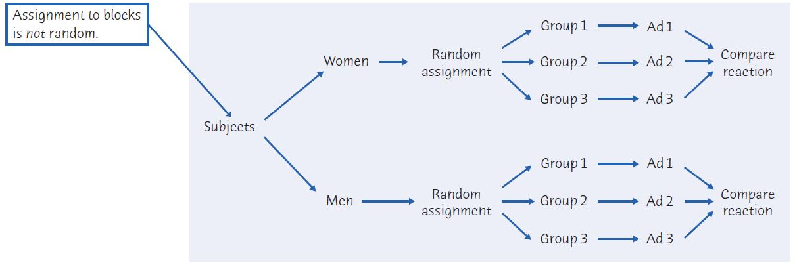
Block design—illustration Example 9.10 – women and men respond differently to advertising

Slide 24
Block Design – another example
Suppose there are 3 flower beds (blocks) with each bed containing 20 plants.
Goal: assess the effect of water temperature and fertilizer type in plant growth.
Two water temperatures: 20℃ and 30℃
And two fertilizer types: A and B
Four treatment combinations → 1) 20℃ with fertilizer A, 2) 20℃ with fertilizer B, 3) 30℃ with fertilizer A and 4) 20℃ with fertilizer B)
Randomization of plants to treatments is performed separately in each block (average of 5 plants per treatment in each block):
Plant 1: Treatment 3)
Plant 2: Treatment 2)
Plant 3: Treatment 4)
Plant 4: Treatment 4)
And so on
Plant 1: Treatment 1)
Plant 2: Treatment 4)
Plant 3: Treatment 2)
Plant 4: Treatment 1)
And so on
Plant 1: Treatment 2)
Plant 2: Treatment 3)
Plant 3: Treatment 4)
Plant 4: Treatment 4)
And so on
Block 1
Block 2
Block 3

